Slide 1
Ottawa Restaurant Analysis
Xiren Ma

Slide 2
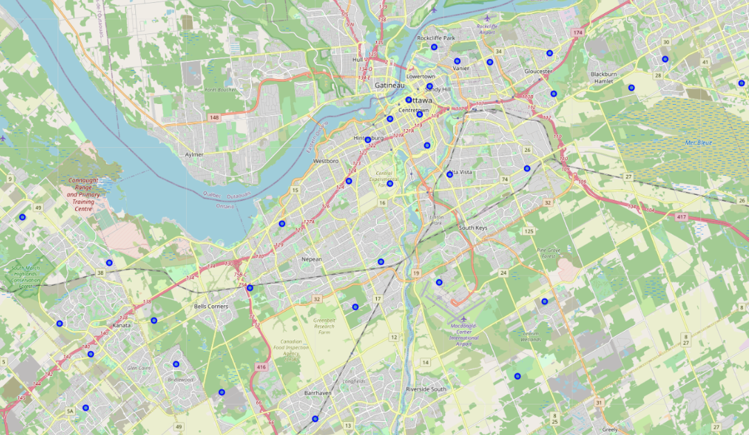
Introduction
Problem Background and Description
Ottawa Overview for Opening a Restaurant
Opening a Restaurant
Select a location
Determine the type of the Restaurant

Slide 3
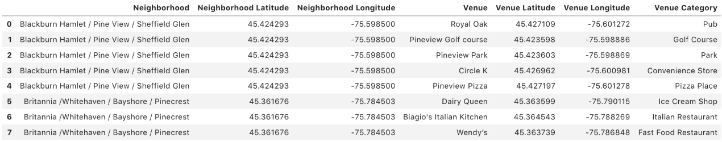
Data Description
Data source for this project
Wikipedia
Foursquare.com
Data Feature
Neighborhoods in Ottawa
Venues in each neighborhood
Name, category, coordinates of each location
Data Process:
Data clean
Data structure format

Slide 4
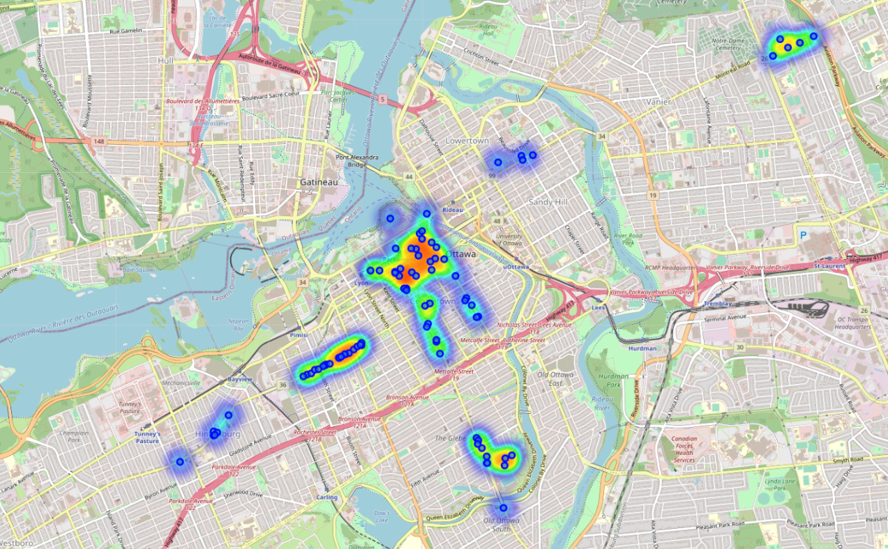
Methodology
Data Scrapping
Scrapping data from Wikipedia
Google geocoder API
Foursquare.com
Visualization
Folium
Location visualization
Density visualization
Cluster visualization
K-means clustering

Slide 5
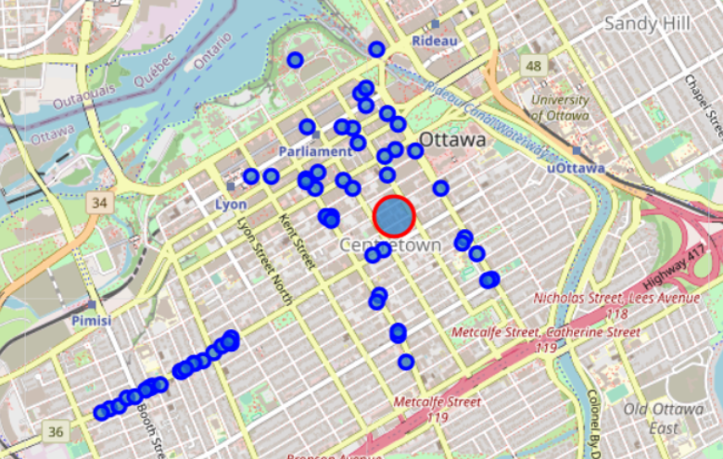
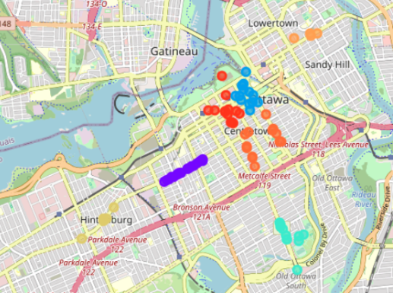
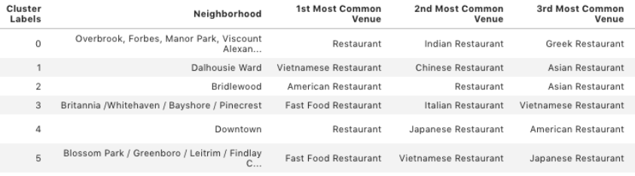
Result
Candidate Location Selection
Select a location based on the restaurant density
downtown of Ottawa (latitude: 45.417623299, longitude: -75.694121)
Restaurant Type Selection
Clustering the restaurant
Select a restaurant based on the number of restaurant ranking
Open a Japanese restaurant or Chinese restaurant

Slide 6


Discussion
Open the same type of restaurant as the most popular restaurant in that area.
Open a Japanese restaurant according to cluster 4.
Open a certain type of restaurant which does not exist in that area.
open a Chinese restaurant according to cluster 4, 13.

Slide 7
Conclusion
Collected and analyzed the restaurant distribution in Ottawa.
Selected a candidate location based on restaurant density.
Estimated two restaurant types based o the clustering and ranking result.
Future, according to the category of other venues, determine a restaurant location.

